Slide 1
CodeU’s
Bootcamp
Chapter 2
Welcome to your 2nd session!
The class will start shortly...
Reproduction and distribution of the presentation deck is prohibited

Slide 2
Agenda for today’s class
Kahoot!
01
02
Course revision
To recap what was seen last class!
Let’s revise last chapter’s material!
Topic of the day:
03
04
Practice time!
Let’s practice with some coding exercises!
Lists
List Manipulations
Wrap-up
Conclusion
05
06
CodeU Robot
Summary of what we’ve learned today
homework and questions

Slide 3

Time for Kahoot!
Head over to Kahoot.it for a fun coding quiz!

Slide 4
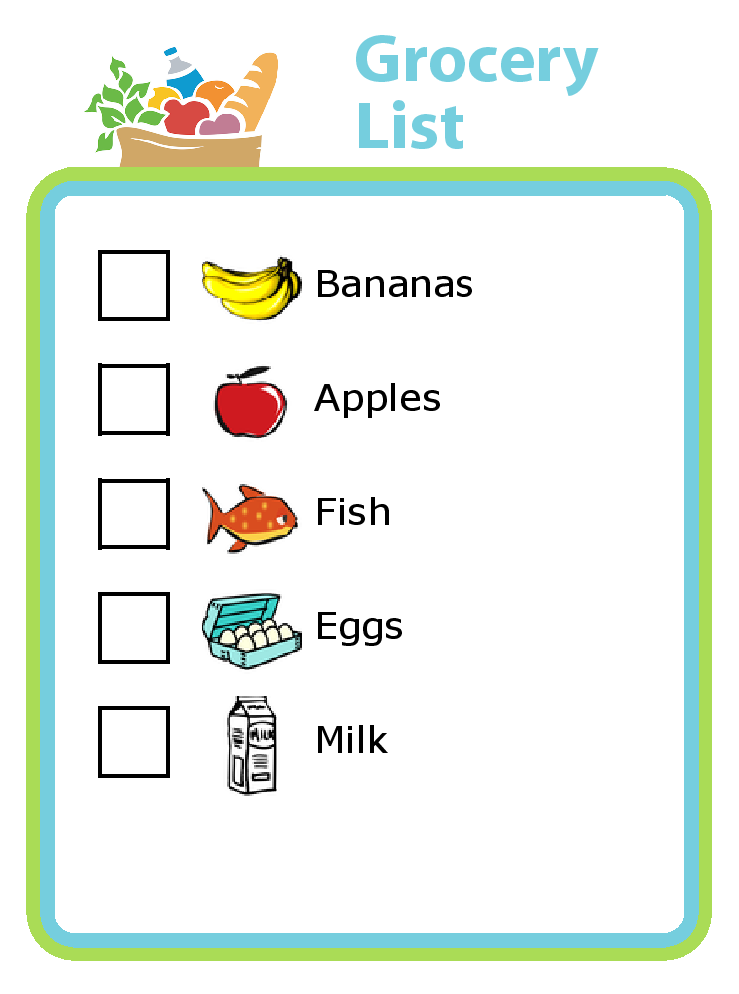
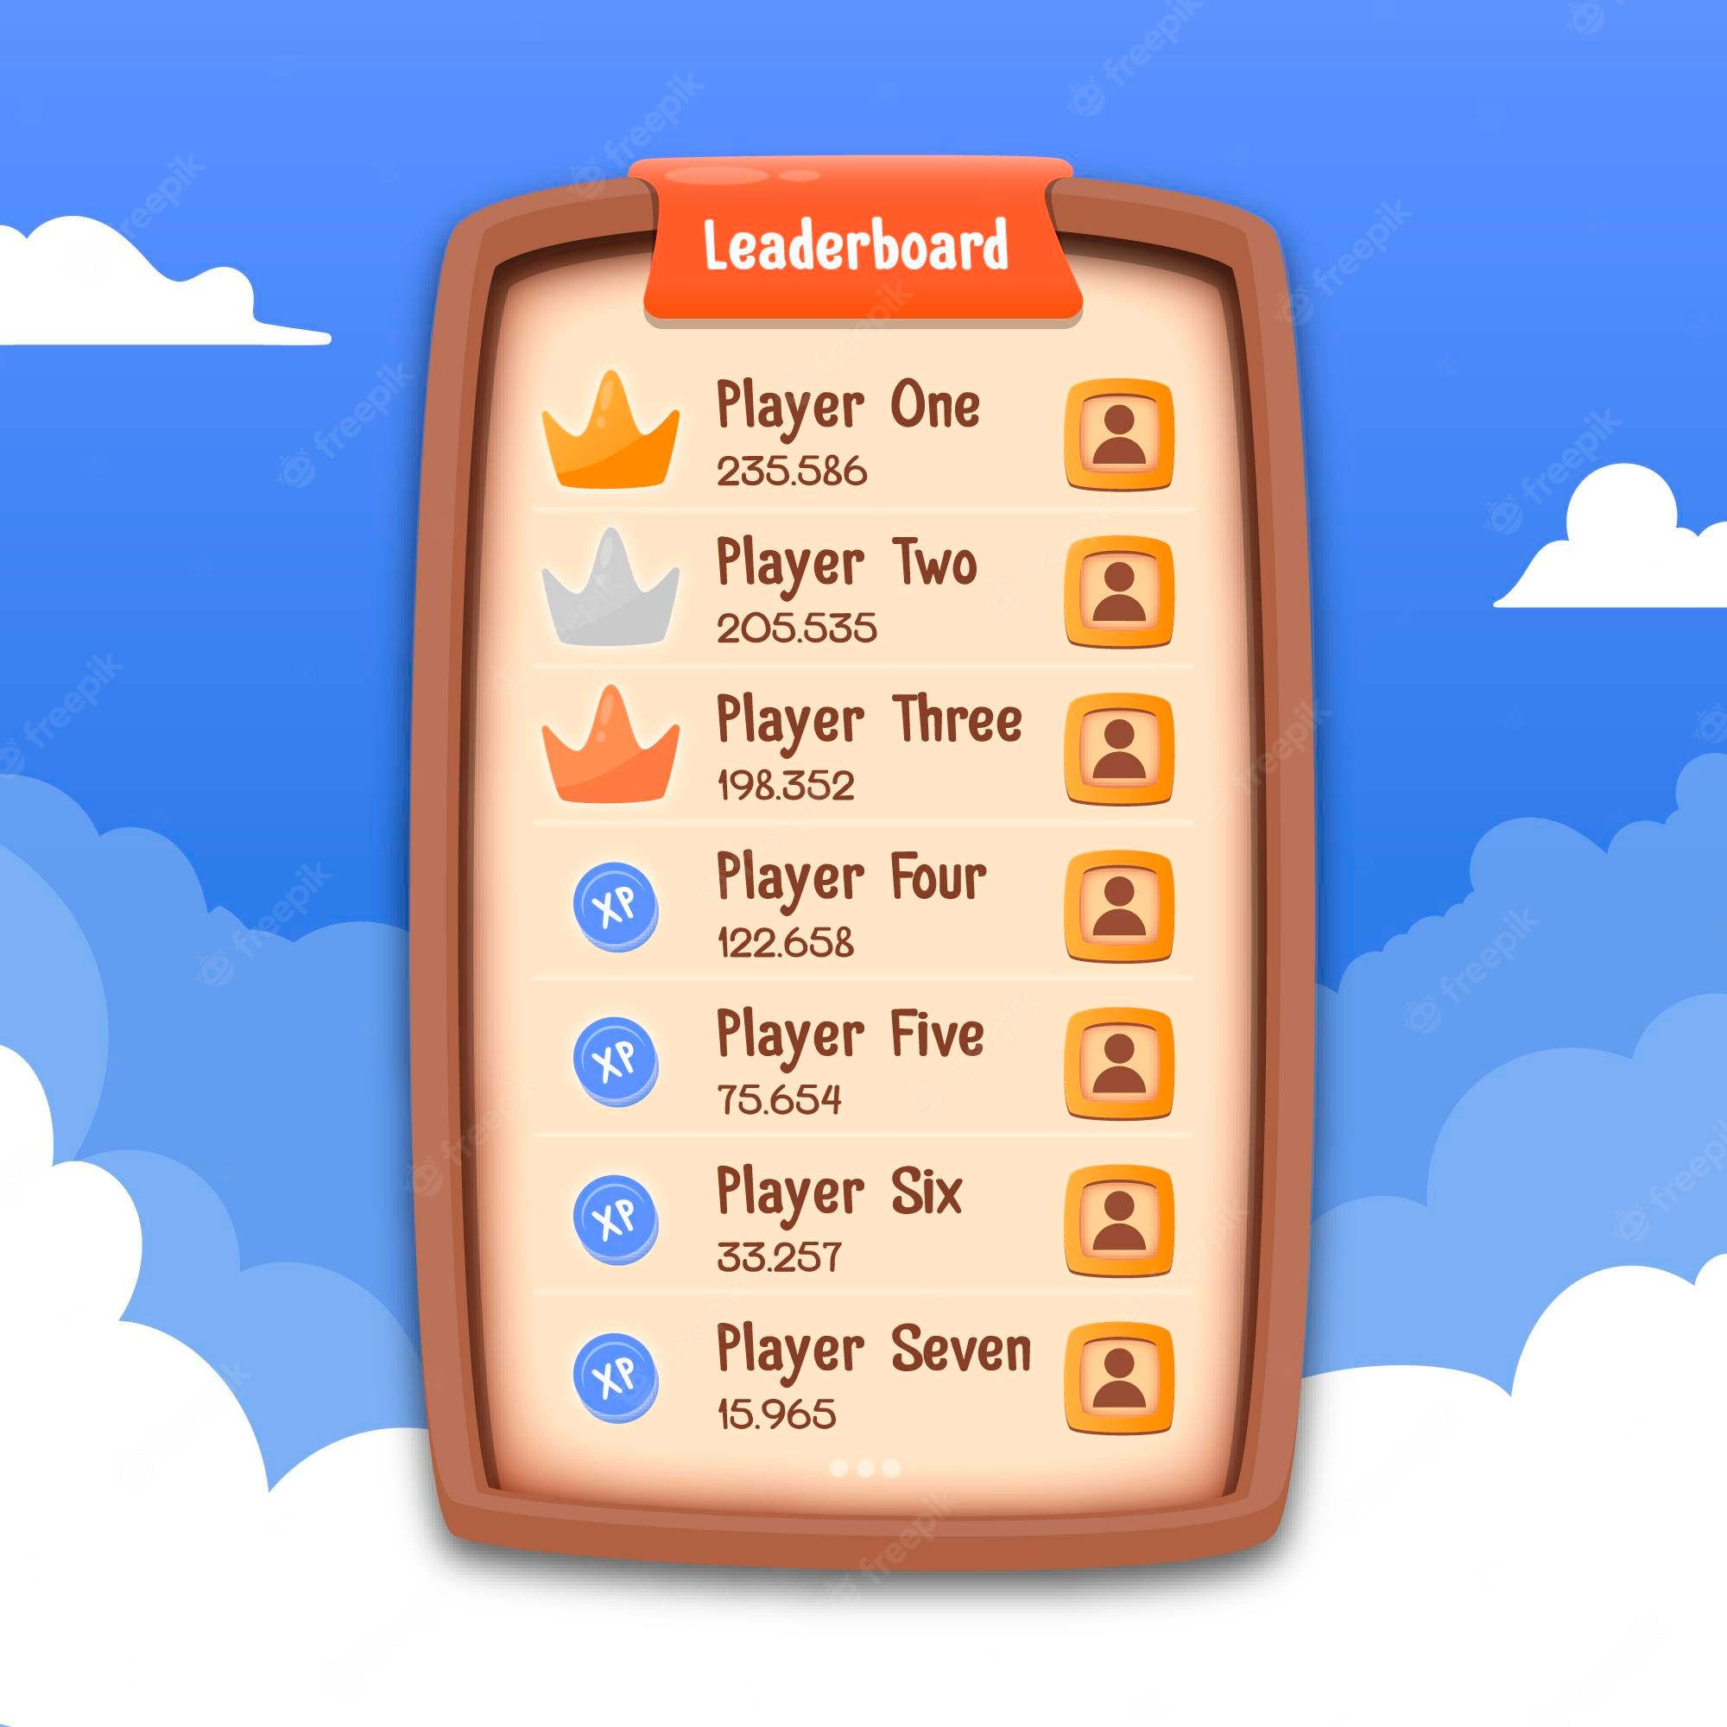

Introduction to LISTS!
01
What are lists?
A list is a number of items in an ordered or unordered structure. A list can be used for a number of things like storing items or deleting and adding items.
Example in a code:
groceryList = [”apples”, “milk”, “cucumbers”, ”cereal”, ”eggs”]
There are lists in our everyday lives. Can you think of one?

Slide 5
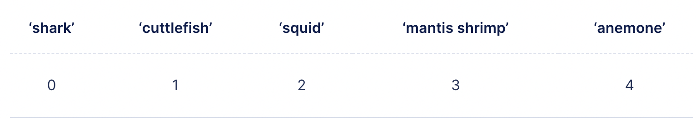
Introduction to LISTS! (cont’)
02
List Manipulation
Lists can be manipulated in many ways. This will allow us to edit the information contained in the list so we can achieve our wanted end result.
Example: In a grocery list, once we found an item, we can remove it from our list.
03
Indexing Lists
Elements in a list are all in different positions. These positions are called indexes.
“shark” is at index 0 in the list
List example: animals = [“shark”, ”cuttlefish”, ”squid”, ”mantis shrimp”, ”anemone”]
animals[0] -> “shark”
animals[2] -> “squid”

Slide 6
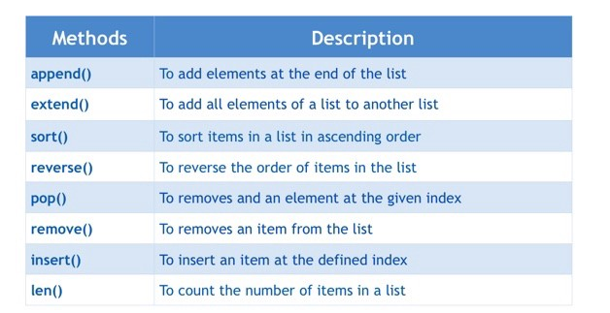
List methods
04
To remove and add an element at the given index

Slide 7
Create a To-Do List
05
Exercise description
The goal of this exercise is to create a To-Do list where you will insert 3 tasks.
Exercise steps
Create a an empty list where you will be inserting your tasks.
Create 3 different variables where you will define your tasks using input. Print your list.
Create a 4th variable that asks the user which task have they completed using input.
Create a set of conditionals that removes the task that was completed. Print the new list.

Slide 8

Homework: List Puzzle!
Homework Description
You must transform an Initial list into the Final list using the list manipulation methods you have learned in class!
Initial List
["Nissan", "Toyota", "Mercedes", "Tesla", "Volvo", "Audi"]
Final List
["Nissan", "Mercedes", "Porsche", "Dodge", "Tesla", "Audi", "Ferrari"]
1
You must complete the transformation in 5 manipulations.
RULES
2
You must use the List manipulation methods learned in class.
3
Print the Final List.

Slide 9




Thank you!
Does anyone have any questions?
Next class: Class 3
Please contact us if you have any questions or if you want to notify us for anything.
Phone:
(438) 391-9106
Email:
hello@codeu.ca

